Slide 1
Yrd. Doç. Dr. Furkan Gözükara
Lisans: İstanbul Teknik Üniversitesi Bilgisayar Mühendisliği, 2004-2009
Yüksek Lisans: Mersin Üniversitesi Bilgisayar Mühendisliği, 2010-2012
Doktora: Çukurova Üniversitesi Bilgisayar Mühendisliği, 2012-2016

Slide 2
CSE214 – Analysis of Algorithms
Lecture 1
Introduction to Analysis of Algorithms
Based on Cevdet Aykanat’s and Mustafa Ozdal’s Lecture Notes - Bilkent

Slide 3
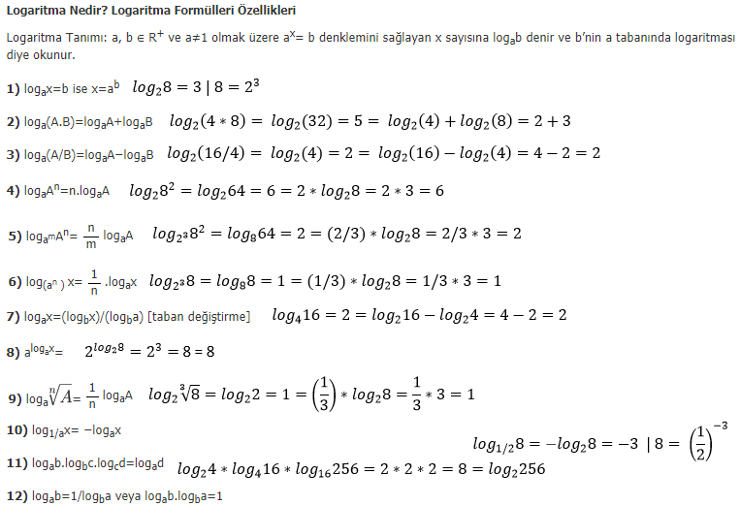

Slide 4

Algorithm Definition
Algorithm: A sequence of computational steps that transform the input to the desired output
Procedure vs. algorithm
◉ An algorithm must halt within finite time with the right output meanwhile procedure may not halt
Example:
a sequence of n numbers
Sorting Algorithm
sorted order of input sequence
Notes:
Sequence dizi

Slide 5
Many Real World Applications
Bioinformatics
Determine/compare DNA sequences
Internet
Manage/manipulate/route data
Information retrieval
Search and access information in large data
Security
Encode & decode personal/financial/confidential data
Electronic design automation
Minimize human effort in chip-design process

Slide 6
Course Objectives
Learn basic algorithms
Gain skills to design new algorithms
Focus on efficient algorithms
Design algorithms that
are fast
use as little memory as possible
are correct!

Slide 7
Outline of Lecture 1
Study two sorting algorithms as examples
Insertion sort: Incremental algorithm
Merge sort: Divide-and-conquer
Introduction to runtime analysis
Best vs. worst vs. average case
Asymptotic analysis

Slide 8
Sorting Problem
Input: Sequence of numbers
⟨a₁, a₂,…, a_{n}⟩
Output: A sorted list
Π= ⟨ Π (1), Π(2),…, Π (n)⟩
such that
ªΠ(1)^{≤a}Π(2) ^{≤ … ≤ a}Π(n)

Slide 9
Insertion Sort
Insertion sort is an incremental algorithm
An incremental algorithm is given a sequence of input, and ﬁnds a sequence of solutions that build incrementally while adapting to the changes in the input
Incremental computation, is a software feature which, whenever a piece of data changes, attempts to save time by only recomputing those outputs which depend on the changed data

Slide 10

Insertion Sort: Basic Idea
Assume input array: A[1..n]
Iterate j from 2 to n
already sorted
j
iter j
insert into sorted array
j
after
iter j
sorted subarray
Notes:
Iterate yinele tekrarla

Slide 11
Pseudo-code notation
Objective: Express algorithms to humans in a clear and concise way
Liberal use of English
Indentation for block structures
Omission of error handling and other details
→ needed in real programs
Notes:
concise özlü , liberal özgürce , indentation girinti , omission ihmal , pseudo sözde kod

Slide 12
Algorithm: Insertion Sort
Insertion-Sort (A)
1. for j ← 2 to n do
2. key ← A[j];
3. i ← j - 1;
4. while i > 0 and A[i] > key
do
A[i+1] ← A[i];
i ← i - 1;
endwhile
7. A[i+1] ← key;
endfor
5.
6.

Slide 13



Algorithm: Insertion Sort
Insertion-Sort (A)
1. for j ← 2 to n do
Iterate over array
2. key ← A[j];
3. i ← j - 1;
4. while i > 0 and A[i] > key
do
A[i+1] ← A[i];
i ← i - 1;
endwhile
7. A[i+1] ← key;
endfor
Loop invariant:
The subarray A[1..j-1] is always sorted
5.
6.
already sorted
j
key

Slide 14


Algorithm: Insertion Sort
Insertion-Sort (A)
1. for j ← 2 to n do
2. key ← A[j];
3. i ← j - 1;
4. while i > 0 and A[i] > key
do
A[i+1] ← A[i];
i ← i - 1;
endwhile
7. A[i+1] ← key;
endfor
Shift right the entries
in A[1..j-1] that are > key
already sorted
5.
6.
j
< key | > key
j
< key |  | > key

Slide 15


Algorithm: Insertion Sort
Insertion-Sort (A)
1. for j ← 2 to n do
2. key ← A[j];
3. i ← j - 1;
4. while i > 0 and A[i] > key
do
A[i+1] ← A[i];
i ← i - 1;
endwhile
7. A[i+1] ← key;
endfor
key
j
now sorted
< key |  | > key
5.
6.
Insert key to the correct location
End of iter j: A[1..j] is sorted

Slide 16
Insertion Sort - Example
Insertion-Sort (A)
1. for j ← 2 to n do
2. key ← A[j];
3. i ← j - 1;
4. while i > 0 and A[i] > key
do
A[i+1] ← A[i];
i ← i - 1;
endwhile
7. A[i+1] ← key;
endfor
5 | 2 | 4 | 6 | 1 | 3
5.
6.

Slide 17






Insertion Sort - Example: Iteration j=2
Insertion-Sort (A)
1. for j ← 2 to n do
key=2
j
5 | 2 | 4 | 6 | 1 | 3
2. key ← A[j];
3. i ← j - 1;
4. while i > 0 and A[i] > key
do
A[i+1] ← A[i];
i ← i - 1;
endwhile
7. A[i+1] ← key;
endfor
initial
sorted
> 2 | j
5 | 2 | 4 | 6 | 1 | 3
5.
6.
shift
sorted
insert key
2
5
4
6
1
3

Slide 18

Insertion Sort - Example: Iteration j=3
Insertion-Sort (A)
1. for j ← 2 to n do
key=4
j
2. key ← A[j];
3. i ← j - 1;
4. while i > 0 and A[i] > key
do
A[i+1] ← A[i];
i ← i - 1;
endwhile
7. A[i+1] ← key;
endfor
2
5
4
6
1
3
initial
sorted
5.
6.
What are the entries at the end of iteration j=3?
? | ? | ? | ? | ? | ?

Slide 19



Insertion Sort - Example: Iteration j=3
Insertion-Sort (A)
1. for j ← 2 to n do
key=4
j
2. key ← A[j];
3. i ← j - 1;
4. while i > 0 and A[i] > key
do
A[i+1] ← A[i];
i ← i - 1;
endwhile
7. A[i+1] ← key;
endfor
2
5
4
6
1
3
initial
sorted
< 4 > 4 |  | j
2 | 5 | 4 | 6 | 1 | 3
5.
6.
shift
sorted
2 | 4 | 5 | 6 | 1 | 3
insert key

Slide 20




Insertion Sort - Example: Iteration j=4
Insertion-Sort (A)
1. for j ← 2 to n do
key=6
j
2. key ← A[j];
3. i ← j - 1;
4. while i > 0 and A[i] > key
do
A[i+1] ← A[i];
i ← i - 1;
endwhile
7. A[i+1] ← key;
endfor
2
4
5
6
1
3
initial
sorted
< 6 |  |  | j
2 | 4 | 5 | 6 | 1 | 3
5.
6.
shift
sorted
insert key
2
4
5
6
1
3

Slide 21

Insertion Sort - Example: Iteration j=5
Insertion-Sort (A)
1. for j ← 2 to n do
key=1
j
2. key ← A[j];
3. i ← j - 1;
4. while i > 0 and A[i] > key
do
A[i+1] ← A[i];
i ← i - 1;
endwhile
7. A[i+1] ← key;
endfor
2
4
5
6
1
3
initial
sorted
5.
6.
What are the entries at the end of iteration j=5?
? | ? | ? | ? | ? | ?

Slide 22


Insertion Sort - Example: Iteration j=5
Insertion-Sort (A)
1. for j ← 2 to n do
key=1
j
2. key ← A[j];
3. i ← j - 1;
4. while i > 0 and A[i] > key
do
A[i+1] ← A[i];
i ← i - 1;
endwhile
7. A[i+1] ← key;
endfor
2
4
5
6
1
3
initial
sorted
>1 >1 >1 >1 |  |  |  | j
2 | 4 | 5 | 6 | 1 | 3
5.
6.
shift
sorted
insert key
1
2
4
5
6
3

Slide 23


Insertion Sort - Example: Iteration j=6
Insertion-Sort (A)
1. for j ← 2 to n do
key=3
 |  |  |  |  | j
1 | 2 | 4 | 5 | 6 | 3
2. key ← A[j];
3. i ← j - 1;
4. while i > 0 and A[i] > key
do
A[i+1] ← A[i];
i ← i - 1;
endwhile
7. A[i+1] ← key;
endfor
initial
sorted
<3 >3 >3 >3 |  |  |  |  | j
1 | 2 | 4 | 5 | 6 | 3
5.
6.
shift
sorted
insert key
1
2
3
4
5
6

Slide 24
Insertion Sort Algorithm - Notes
Items sorted in-place
Elements rearranged within array
At most constant number of items stored outside the array at any time (e.g. the variable key)
Input array A contains sorted output sequence when the algorithm ends
Incremental approach
Having sorted A[1..j-1], place A[j] correctly so that A[1..j] is sorted

Slide 25
Running Time
Depends on:
Input size (e.g., 6 elements vs 6,000,000 elements)
Input itself (e.g., partially sorted)
Usually want upper bound

Slide 26
Kinds of running time analysis
Worst Case (Usually)
T(n) = max time on any input of size n
Average Case (Sometimes)
T(n) = average time over all inputs of size n Assumes statistical distribution of inputs
Best Case (Rarely)
T(n) = min time on any input of size n
BAD*: Cheat with slow algorithm that works fast on some inputs
GOOD: Only for showing bad lower bound
*Can modify any algorithm (almost) to have a low best-case running time
Check whether input constitutes an output at the very beginning of the algorithm
Notes:
Constitute teşkil etmek oluşturmak

Slide 27
Running Time
For Insertion-Sort, what is its worst-case time?
Depends on speed of primitive operations
Relative speed (on same machine)
Absolute speed (on different machines)
Asymptotic analysis
Ignore machine-dependent constants
Look at growth of T(n) as n→∞

Slide 28
Θ Notation
Drop low order terms
Ignore leading constants e.g.
2n²+5n + 3 = Θ(n²)
3n³+90n²-2n+5= Θ(n³)
Formal explanations in the next lecture.

Slide 29
As n gets large, a Θ(n²) algorithm runs faster than a Θ(n³) algorithm
T(n)
Runtime larger asymptotically
n
min value for n₀

Slide 30

Insertion Sort – Runtime Analysis
Cost
Insertion-Sort (A)
^{c}1
1. for j ← 2 to n do
2. key ← A[j];
3. i ← j - 1;
4.while i >= 0 and A[i] > key
do
A[i+1] ← A[i];
i ← i - 1;
endwhile
7. A[i+1] ← key;
endfor
^{c}2
c c
3
4
t_{j}: The number of times while loop test is executed for j
5.
6.
c₅ c₆
c₇

Slide 31
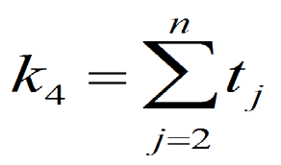
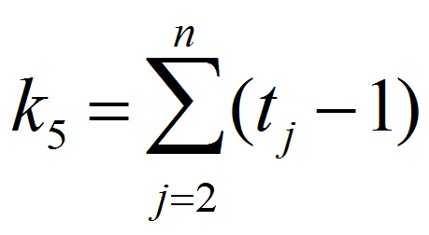
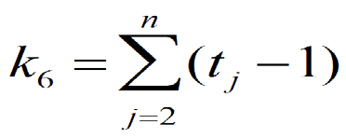
How many times is each line executed?
# times
Insertion-Sort (A)
n n-1
1. for j ← 2 to n do
2. key ← A[j];
3. i ← j - 1;
4.while i >= 0 and A[i] > key
do
A[i+1] ← A[i];
i ← i - 1;
endwhile
7. A[i+1] ← key;
endfor
n-1
k₄
5.
6.
^{k}5
k₆
n-1

Slide 32
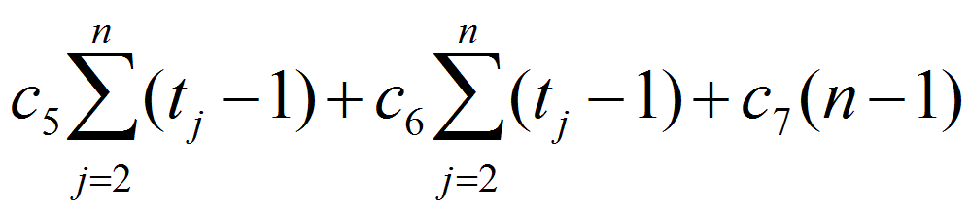
Insertion Sort – Runtime Analysis
Sum up costs:
T (n) = c₁n + c₂ (n −1) + c₃ (n −1) + c₄∑t_{j} +
j =2
n
What is the best case runtime?
What is the worst case runtime?

Slide 33
Question: If A[1...j] is already sorted, t_{j} = ?
Insertion-Sort (A)
1. for j ← 2 to n do
key=6
j
2. key ← A[j];
3. i ← j - 1;
4. while i >= 0 and A[i] > key
do
A[i+1] ← A[i];
i ← i - 1;
endwhile
7. A[i+1] ← key;
endfor
2
4
5
6
1
3
initial
sorted
< 6 |  |  | j
2 | 4 | 5 | 6 | 1 | 3
5.
6.
shift none
t_{j} = 1

Slide 34
Insertion Sort – Best Case Runtime
Original function:
T (n) = c₁n + c₂ (n −1) + c₃ (n −1) + c₄∑t_{j} +
j =2
n
Best-case: Input array is already sorted
t_{j} = 1 for all j

Slide 35
Q: If A[j] is smaller than every entry in A[1..j-1], t_{j} = ?
Insertion-Sort (A)
1. for j ← 2 to n do
key=1
j
2. key ← A[j];
3. i ← j - 1;
4. while i >= 0 and A[i] > key
do
A[i+1] ← A[i];
i ← i - 1;
endwhile
7. A[i+1] ← key;
endfor
2
4
5
6
1
3
initial
sorted
>1 >1 >1 >1 |  |  |  | j
2 | 4 | 5 | 6 | 1 | 3
5.
6.
shift all
t_{j} = j

Slide 36
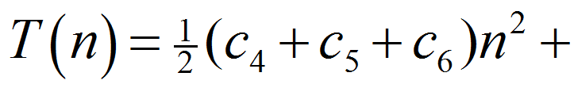

Insertion Sort – Worst Case Runtime
Worst case: The input array is reverse sorted
t_{j} = j for all j
After derivation, worst case runtime:

Slide 37
Asymptotic Notation
This will be explained in further lessons
Just for now, it simply means that how our algorithm’s run time grows as the number of inputs grows to the infinity

Slide 38
Insertion Sort – Asymptotic Runtime Analysis
Insertion-Sort (A)
1. for j ← 2 to n do
2. key ← A[j];
3. i ← j - 1;
4. while i >= 0 and A[i] > key
do
A[i+1] ← A[i];
i ← i - 1;
endwhile
7. A[i+1] ← key;
endfor
Θ(1)
5.
6.
Θ(1)
Θ(1)

Slide 39
Asymptotic Runtime Analysis of Insertion-Sort
Worst-case (input reverse sorted)
– Inner loop is Θ(j)
⎛ ⎞
T (n) = ∑Θ( j) = Θ⎜∑ j ⎟ = Θ(n )
n
n
2
j =2
⎝ j =2
⎠
Average case (all permutations equally likely)
– Inner loop is Θ(j/2)
T (n) = ∑Θ( j 2) = ∑Θ( j) = Θ(n² )
n n
j =2 j =2
Often, average case not much better than worst case
Is this a fast sorting algorithm?
– Yes, for small n. No, for large n.

Slide 40
Merge Sort
Merge Sort is a divide and conquer type algorithm
Divide and Conquer basically works in three steps: 1. Divide - It first divides the problem into small chunks or sub-problems 2. Conquer - It then solve those sub-problems recursively so as to obtain a separate result for each sub-problem 3. Combine - It then combine the results of those sub-problems to arrive at a final result of the main problem

Slide 41




Merge Sort: Basic Idea
Input array A
Divide
sort this half
sort this half
Conquer
merge two sorted halves
Combine

Slide 42
Merge-Sort (A, p, r)
if p = r then return; else
q ← ⎣ (p+r)/2⎦;
(Divide)
Merge-Sort (A, p, q); Merge-Sort (A, q+1, r); Merge (A, p, q, r);
endif
(Conquer) (Conquer) (Combine)
Call Merge-Sort(A,1,n) to sort A[1..n]
Recursion bottoms out when subsequences have length 1

Slide 43



Merge Sort: Example
Merge-Sort (A, p, r)
if p = r then
p
q
r
return else
q ← ⎣ (p+r)/2⎦
5 | 2 | 4 | 6 | 1 | 3
p
q
r
2 | 4 | 5
1 | 3 | 6
Merge-Sort (A, p, q) Merge-Sort (A, q+1, r)
Merge(A, p, q, r)
endif
1 | 2 | 3 | 4 | 5 | 6

Slide 44


How to merge 2 sorted subarrays?
A[p..q]
2 | 4 | 5
1 | 2 | 3 | 4 | 5 | 6
A[q+1..r]
1 | 3 | 6
What is the complexity of this step?
Θ(n)

Slide 45

Merge Sort: Complexity
Merge-Sort (A, p, r)
T(n)
if p = r then
return else
q ← ⎣ (p+r)/2⎦
Θ(1)
Θ(1)
T(n/2)
T(n/2)
Merge-Sort (A, p, q)
Merge-Sort (A, q+1, r)
Merge(A, p, q, r)
endif
Θ(n)

Slide 46
Merge Sort – Recurrence
Describe a function recursively in terms of itself
To analyze the performance of recursive algorithms
For merge sort:
Θ(1)
2T(n/2) + Θ(n)
if n=1
T(n) =
otherwise

Slide 47
How to solve for T(n)?
Θ(1)
2T(n/2) + Θ(n)
if n=1
T(n) =
otherwise
Generally, we will assume T(n) = Θ(1) for sufficiently small n
The recurrence above can be rewritten as:
T(n) = 2 T(n/2) + Θ(n)
How to solve this recurrence?

Slide 48


Solve Recurrence: T(n) = 2T (n/2) + Θ(n)
Θ(n)
T(n/2)
T(n/2)

Slide 49





Solve Recurrence: T(n) = 2T (n/2) + Θ(n)
Θ(n)
Θ(n/2)
Θ(n/2)
each size
halved
2x
subprobs
T(n/2)
T(n/4)
T(n/4)
T(n/4)
T(n/4)

Slide 50





Solve Recurrence: T(n) = 2T (n/2) + Θ(n)
Θ(n)
Θ(n)
Θ(n/2)
Θ(n/2)
Θ(n)
Θ(lgn)
T(n/4)
T(n/4)
T(n/4)
T(n/4)
Θ(1)
Θ(1) Θ(1)
Θ(1)
Θ(1) Θ(1)
Θ(1)
Θ(1)
Θ(1) Θ(n)
Θ(n)
Total: Θ(nlgn)

Slide 51
Merge Sort Complexity
Recurrence:
T(n) = 2T(n/2) + Θ(n)
Solution to recurrence:
T(n) = Θ(nlgn)

Slide 52
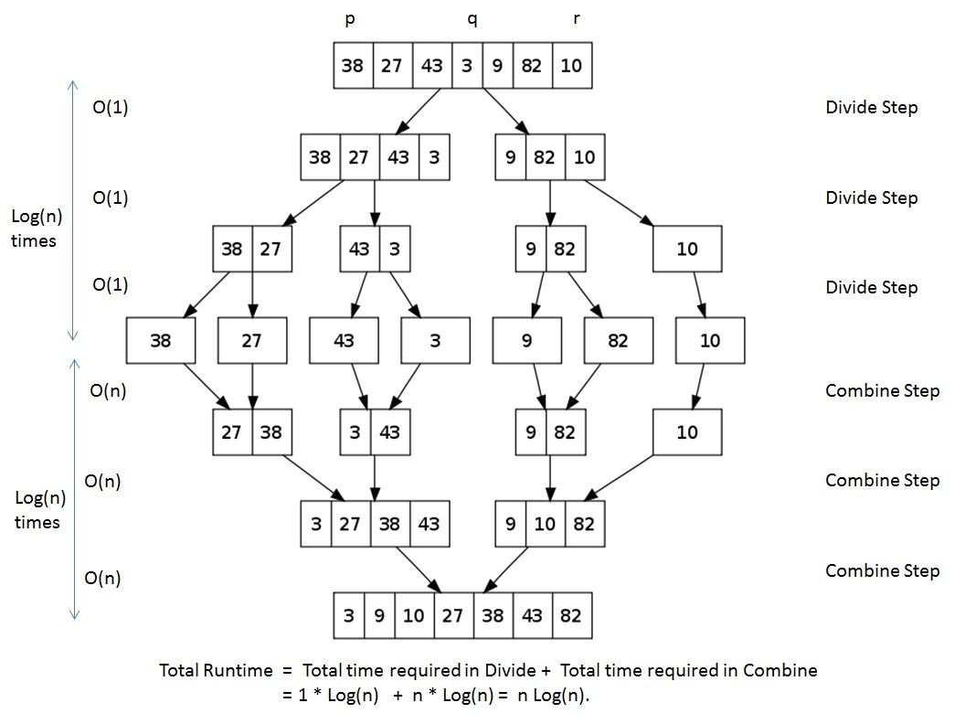

Slide 53
Conclusions: Insertion Sort vs. Merge Sort
Θ(nlgn) grows more slowly than Θ(n²)
E.g. n=1,000 > Merge sort = 1000*log(1000)= 9,965 | Insertion Sort = 1000*1000=1,000,000
Therefore Merge-Sort beats Insertion-Sort in the worst case
In practice, Merge-Sort beats Insertion-Sort for n>30
or so.

Slide 54
Project Work 1 : 10 points
Code merge sort and insertion sort in any programming language
Generate 100,000 random integers between 1 and 2,000,000,000
Put those integers into an array or list
Sort this list both with insertion sort and merge sort algorithms
Calculate the exact time requirement for each sorting algorithm

Slide 55
Project Work 1 : 10 points
Only calculate the algorithm running part’s run time
Do sorting at least 5 times and take average run time to calculate each algorithms more precise run time
Print average running times to the screen
While running, the software should print at which stage the algorithm is

Slide 56
Project Work 1 : 10 points
The software you have coded will be checked and evaluated at the next week’s (12.03.2018) lesson on your computer
So bring the program and your laptop to the next lesson
Also please RAR(Winrar) or ZIP(Winzip) your software project and email to furkangozukara@gmail.com with including your full name and your student number

